Slide 1
Develop your whole self…
RUSHEY
3
passport
… with French music!
RUSHEY
3
passport

Slide 2
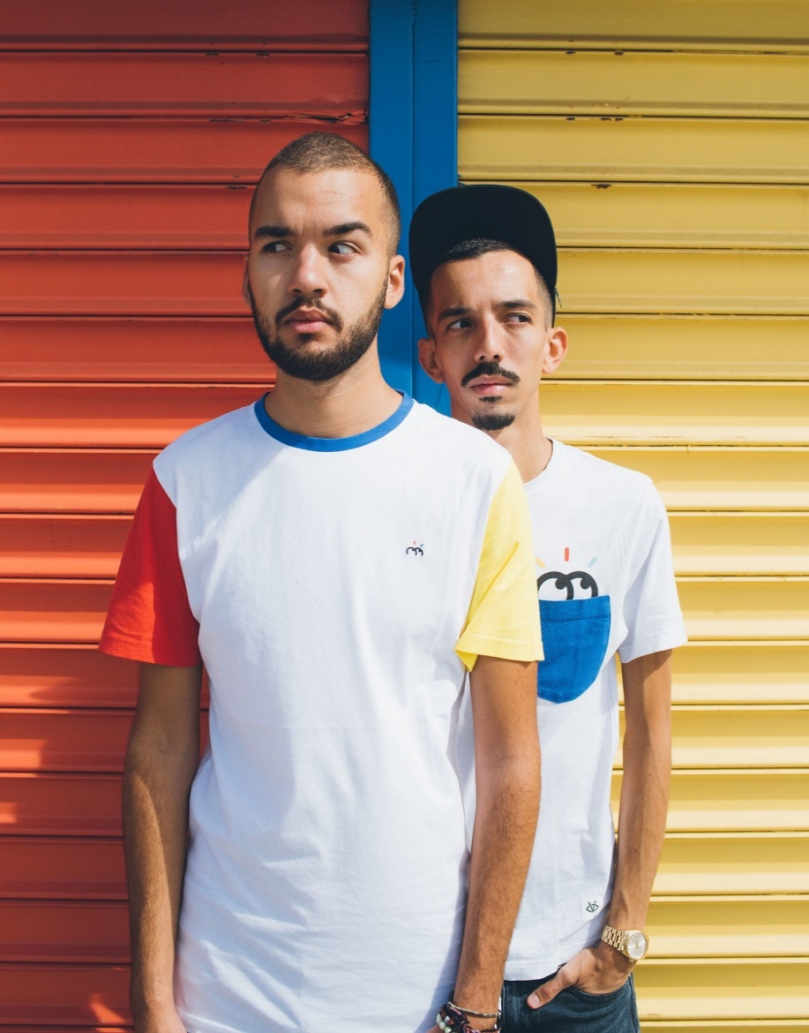






Bigflo et Oli
Bigflo & Oli are a French hip-hop duo. The duo is composed of two brothers, Florian "Bigflo" Ordoñez and Olivio "Oli" Ordoñez. Bigflo & Oli were born from an Argentine father Fabian and a French mother of Algerian descent, and grew up in Toulouse, France.
Genre: Hip hop, rap
Albums: La cour des grands, La vraie vie
La vie de rêve
Songs: Dommage, Demain, Plus tard
Check out their YouTube channel
Follow @bigfloetoli on Twitter, Instagram and Facebook

Slide 3
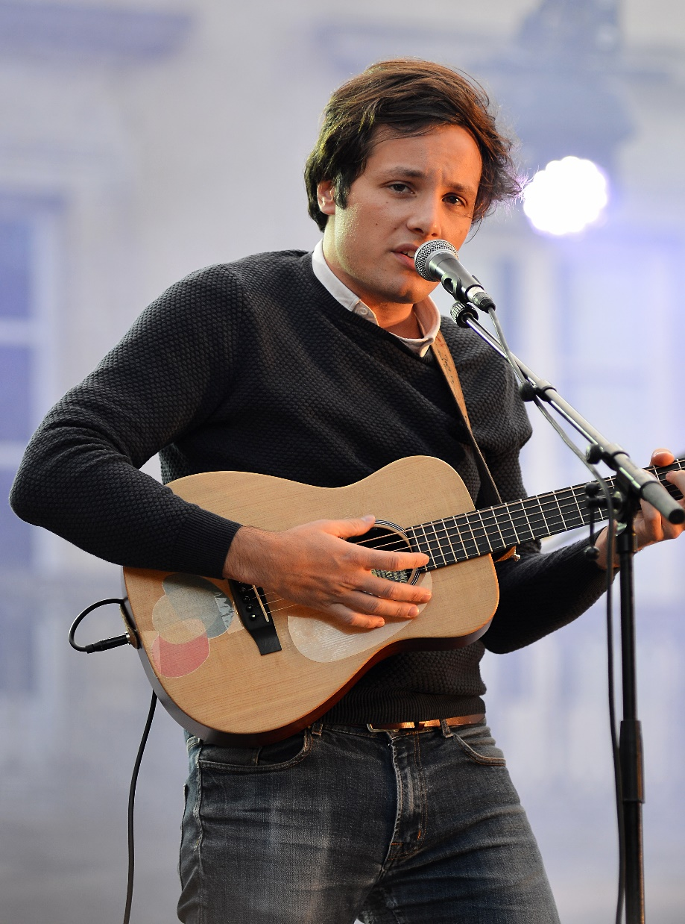
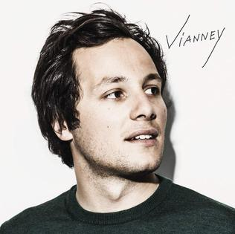
Vianney
Vianney is a French singer-songwriter, who grew up in a music loving family. He discovered a passion for music at the age of 12 and began to write his own songs from then on. At 24 years old, he won the award for performing artist of the year at the Victoires de la musique 2016.
Genre: French pop
Albums: Idées blanches, Vianney
Songs: Je m’en vais, La même, Dumbo
Check out his YouTube channel
Follow @vianneymusique on Twitter, Instagram and Facebook

Slide 4
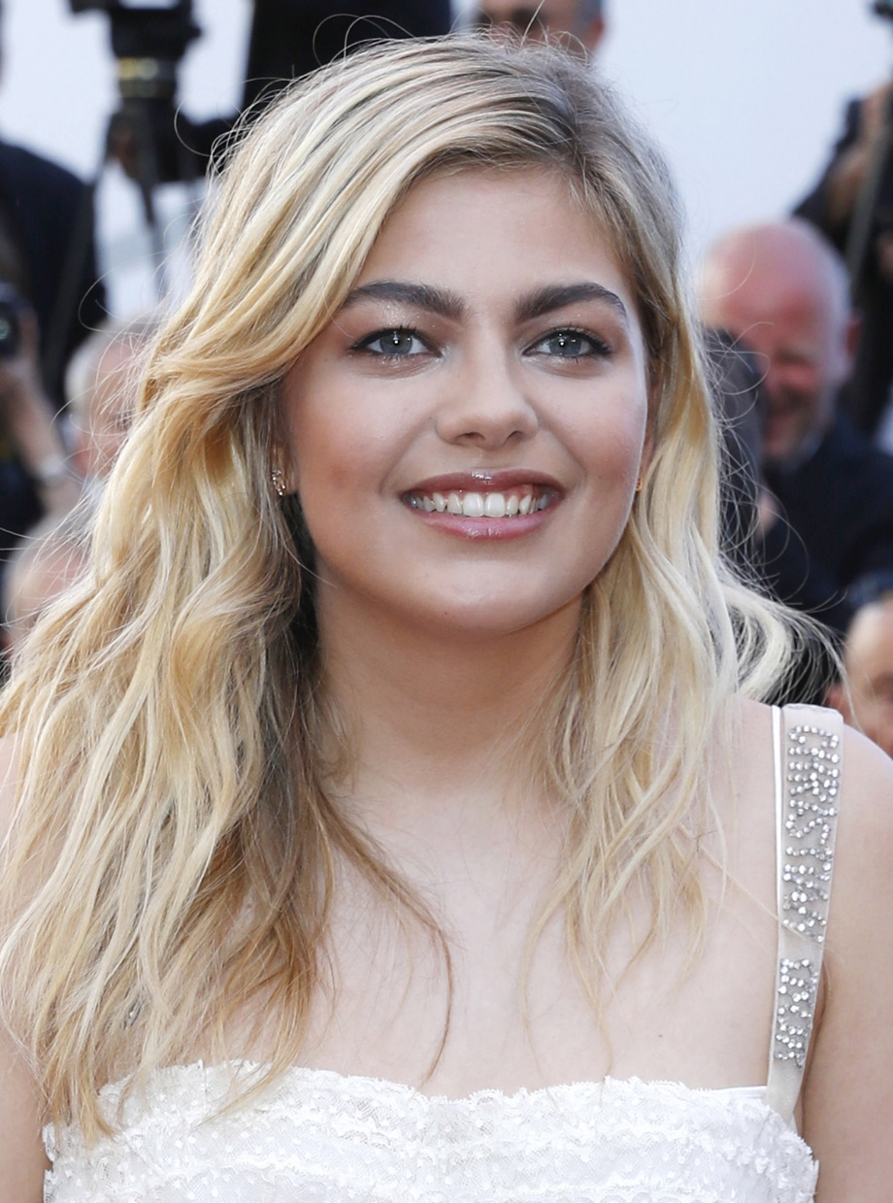
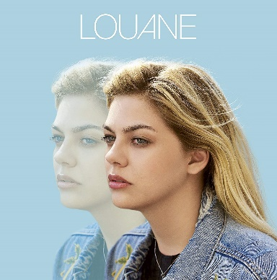
Louane
Louane is a French singer and actress. She is best known for being a semi-finalist in the second season of The Voice. She later got a role in La Famille Bélier which won her a César Award. In 2017, she provided vocals for the track, It Won't Kill Ya, from The Chainsmokers' debut album.
Genre: French pop, electronica
Albums: Chambre 12, Louane
Songs: Avenir, Immobile, Je vole
Check out her YouTube channel
Follow @louane on Twitter, Instagram and Facebook

Slide 5
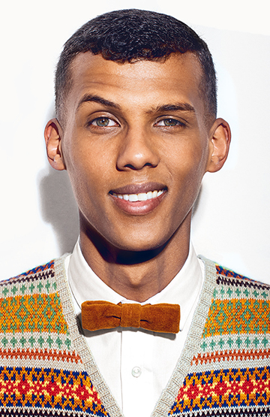
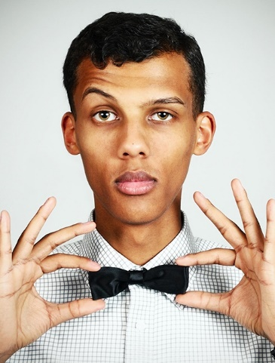
Stromae
Stromae, (which is "Maestro" with the syllables reversed following the French slang practice, verlan) is a Belgian musician, rapper, singer and songwriter. He became famous in 2009 with his song Alors, on danse, which became a number one in several European countries.
Genre: Hip hop, electronic
Albums: Cheese, Racine carrée
Songs: Papaoutai, Formidable, Ta fête
Check out his YouTube channel
Follow @stromae on Twitter, Instagram and Facebook

Slide 6

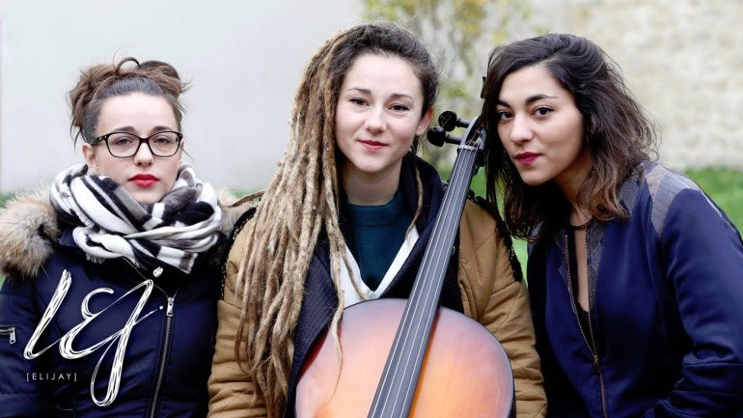
L.E.J.
L.E.J, short for Lucie, Élisa and Juliette, is a French band composed of three childhood friends from Saint-Denis, in Paris' suburbs. They got famous by condensing numerous top songs from the summer of 2015 into a mashup performance. Their song mashup Summer 2015 had millions of plays on YouTube becoming a global hit in less than a month
Genre: Pop, classical, electronic
Albums: Poupées russes
Songs: La dalle, La nuit, Liberté égalité
Check out their YouTube channel
Follow @LucieElisaJuliette on Twitter, Instagram and Facebook

Slide 7
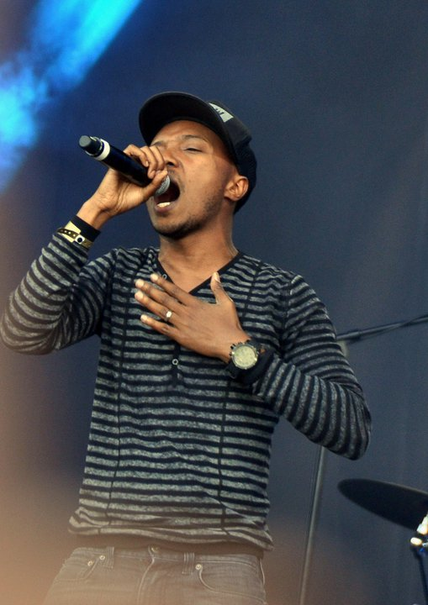
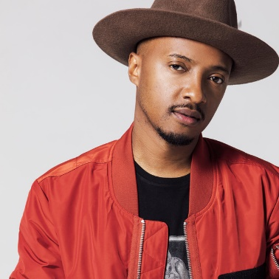
Soprano
Soprano is a French singer and rapper. He is a part of the rap group Psy 4 de la Rime, a French hip hop band formed in 1992 in Marseille comprising of several rappers with immigrant backgrounds from former French colonies. After their split, Soprano went on to have a very successful solo career.
Genre: Hip hop, rap, urban music
Albums: L’Everest, Phoenix
Songs: Zoum, En feu, Mon précieux
Check out his YouTube channel
Follow @sopranopsy4 on Twitter and Instagram and @sopranofficiel on Facebook

Slide 8


Black M
Black M (Black Mesrimes) is a French rapper and singer-singwriter from Paris. He is famous for his membership in the French rap and hip hop collective Sexion d'Assaut in addition to his solo work and collaborations with various artists. Black M uses many punch lines and onomatopoeias in his works.
Genre: Hip hop, R&B
Albums: Éternel insatisfait
Il était une fois
Songs: Mon beau-frère, Sur ma Route, French kiss
Check out his YouTube channel
Follow @Bmesrimes on Twitter, @blackm on Instagram and @Blackmesrimesofficiel on Facebook

Slide 9
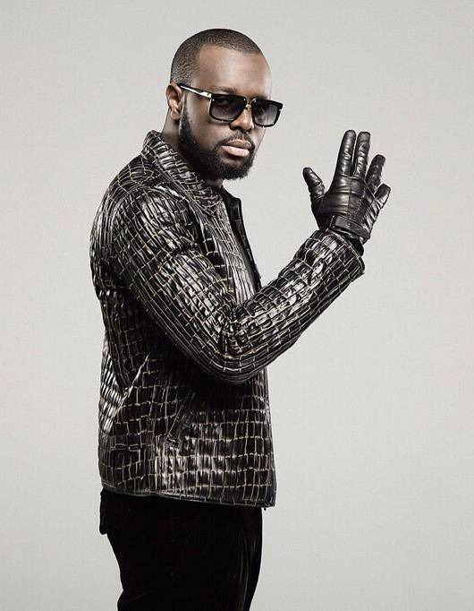
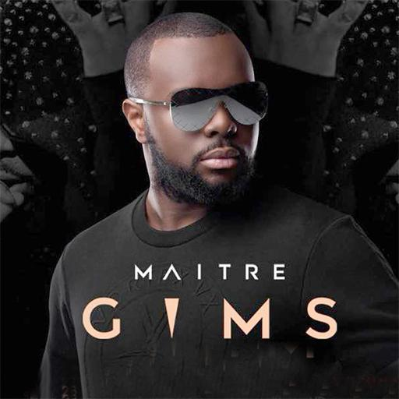
Maître Gims
Maître Gims or just Gims, is a Congolese singer, rapper and composer. He grew up in France and currently lives in France and Morocco. He is a former member of the hip hop group Sexion d'Assaut, and released his major label debut album, Subliminal, in 2013.
Genre: Hip hop, R&B
Albums: Mon coeur avait raison, Ceinture noire
Songs: Reste, La même, Est-ce que tu m’aimes?
Check out his YouTube channel
Follow @MaitreGIMs on Twitter, @gims on Instagram and @maitregimsoff on Facebook

Slide 10
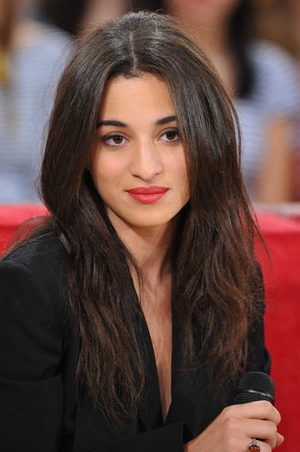
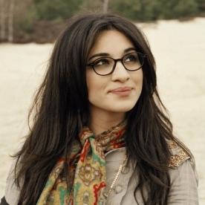
Camélia Jordana
Camélia Jordana Riad-Aliouane is a French pop singer and actress. Jordana was born in Toulon, to French parents of Algerian descent. She rose to fame at 16 years old, after participating in the television show Nouvelle Star, the French version of Pop Idol, in 2009, where she came third.
Genre: French pop, folk pop
Albums: Camélia Jordana, Dans la peau
LOST
Songs: Dans la peau, Non non non, Moi c’est
Check out her YouTube channel
Follow @Camelia_Jordana on Twitter, @cjjordana on Instagram and @camellia.jordana on Facebook

Slide 11
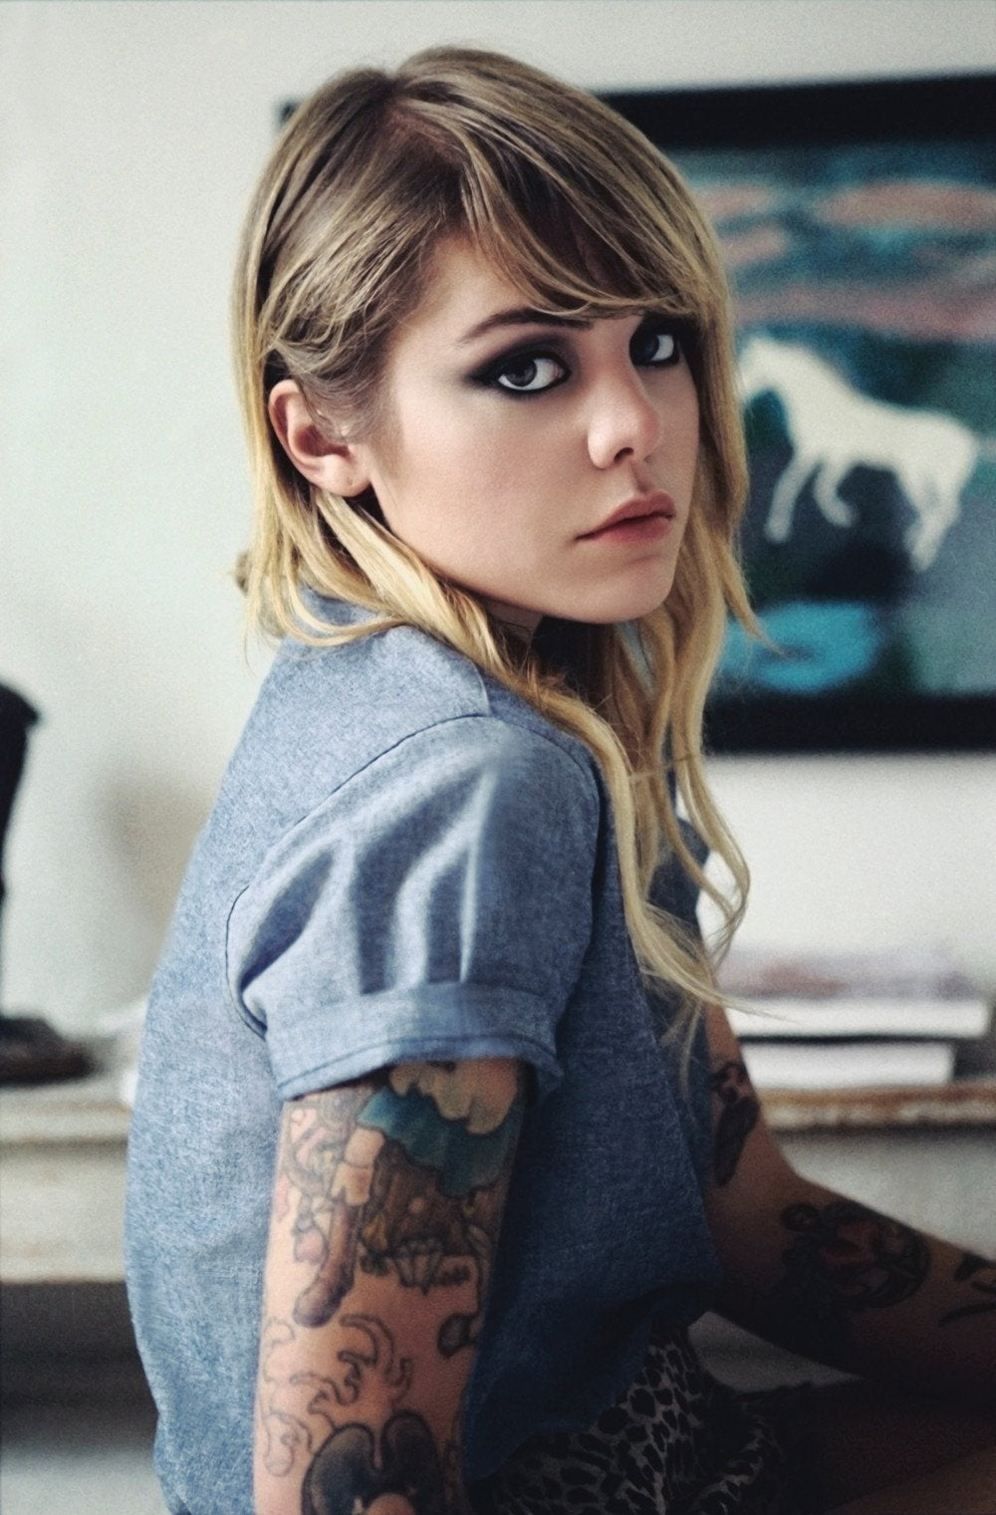
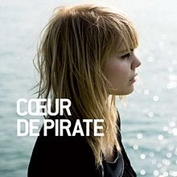
Coeur de Pirate
Béatrice Martin, better known by her stage name Cœur de pirate is a Canadian singer-songwriter and pianist. Born in the province of Quebec, she started playing the piano when she was only three years old, she sings mostly in French and has been credited in ’Montreal Mirror’ with “bringing la chanson française to a whole new generation of Quebec youth”.
Genre: Indie pop, folk pop
Albums: Coeur de Pirate, Blonde, Trauma
Songs: Comme des enfants, Ne m’appelle pas,
Dans la nuit
Check out her YouTube channel
Follow @beatricepirate on Instagram and Twitter or @coeurdepirate.officiel on Facebook

Slide 12
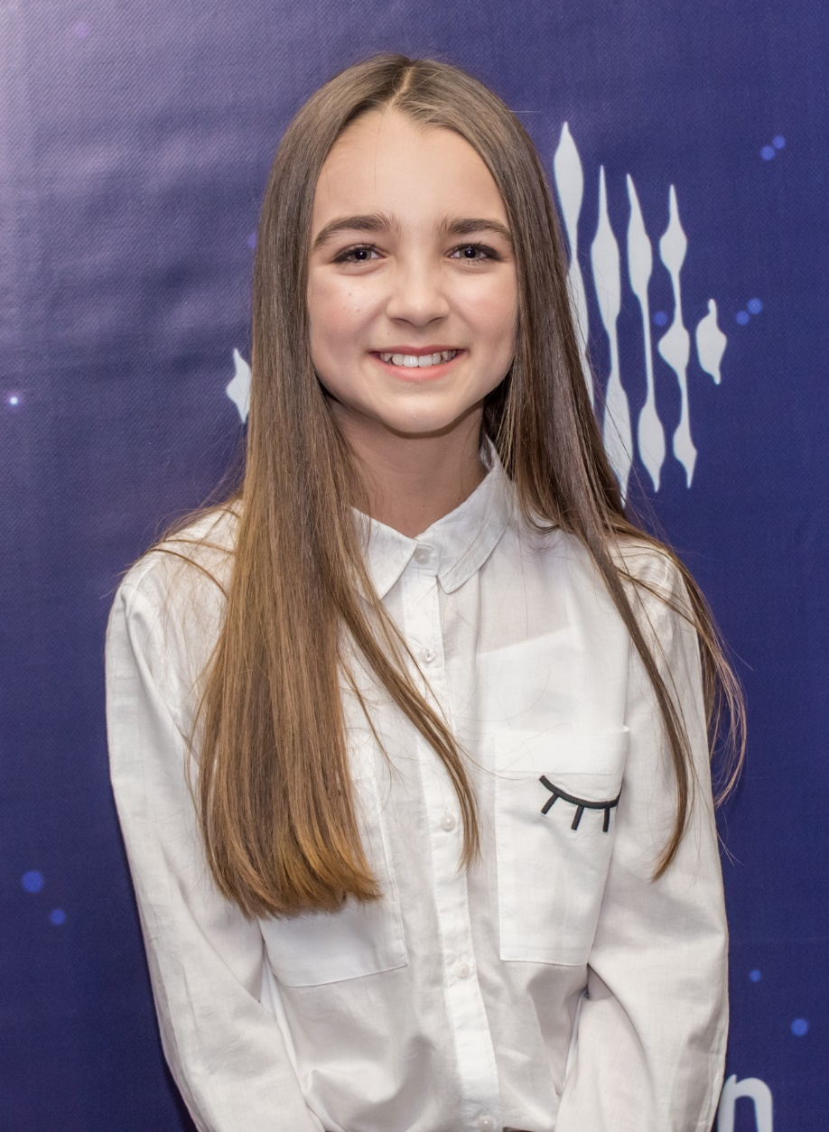

Angelina
Angelina is a French singer, from Provence in Southern France, who achieved fame after winning the fourth French season of The Voice Kids. A year later, she represented her country at the 2018 Junior Eurovision Song Contest with the song "Jamais sans toi", finishing second.
Genre: French pop, teen pop
Albums: Maman me dit, Roule,
Qui dit mieux
Songs: Ma voie
Check out her YouTube channel
Follow @Angelinanava on Instagram, Twitter and Facebook

Slide 13
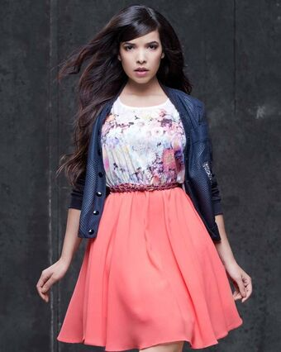
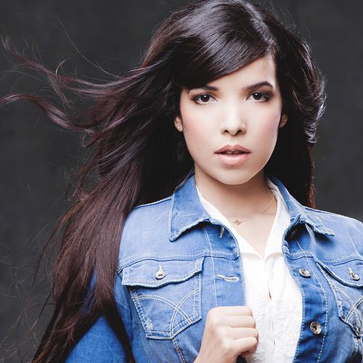
Indila
Adila Sedraïa, best known by her stage name Indila, is a French singer and songwriter. Indila was born in Paris but describes herself as a "child of the world". She is of Algerian, Egyptian, Indian and Cambodian descent and says that her stage name Indila comes from her love for India.
Genre: French pop, R&B
Albums: La dernière danse,
Tourner dans le vide, Parle à ta tête
Songs: Mini world
Check out her YouTube channel
Follow @IndilaOfficiel on Instagram, Twitter and Facebook

Slide 14
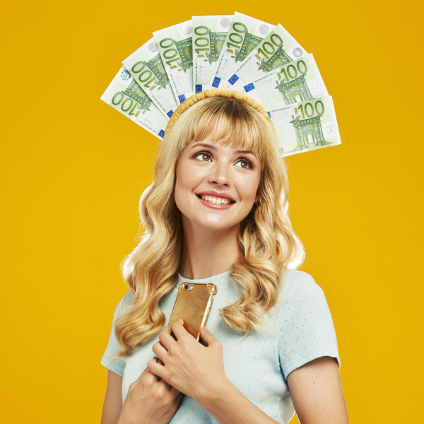
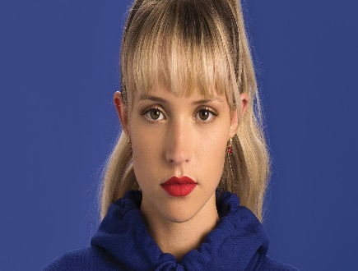
Angèle
Angèle is a Belgian singer-songwriter and musician. She was one of 2018's biggest breakout acts in French and Belgian pop, breaking Stromae's record for weeks at the top of the Belgian singles charts with her 2018 single "Tout oublier" which features her brother Roméo Elvis.
Genre: French pop
Albums: Tout oublier
Oui ou non, Balance ton quoi
Songs: Brol, Brol la suite
Check out her YouTube channel
Follow @angele_vl on Instagram or @angeleouenpoudre on Facebook

Slide 15
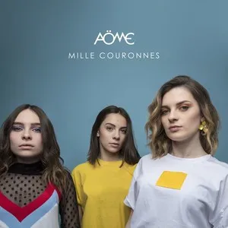
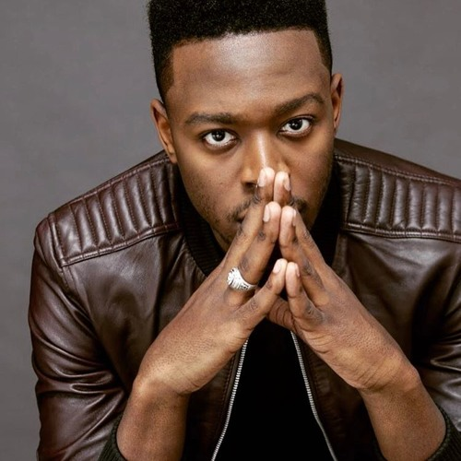
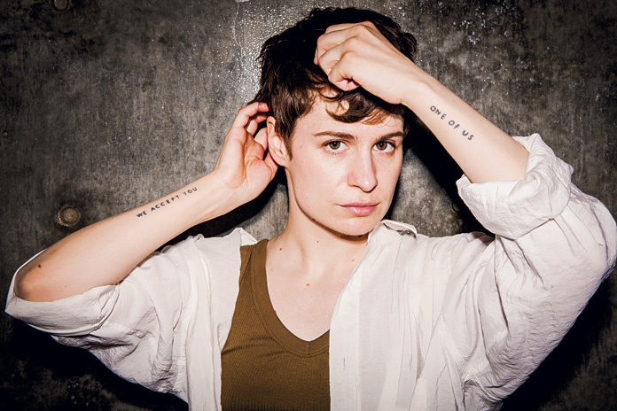
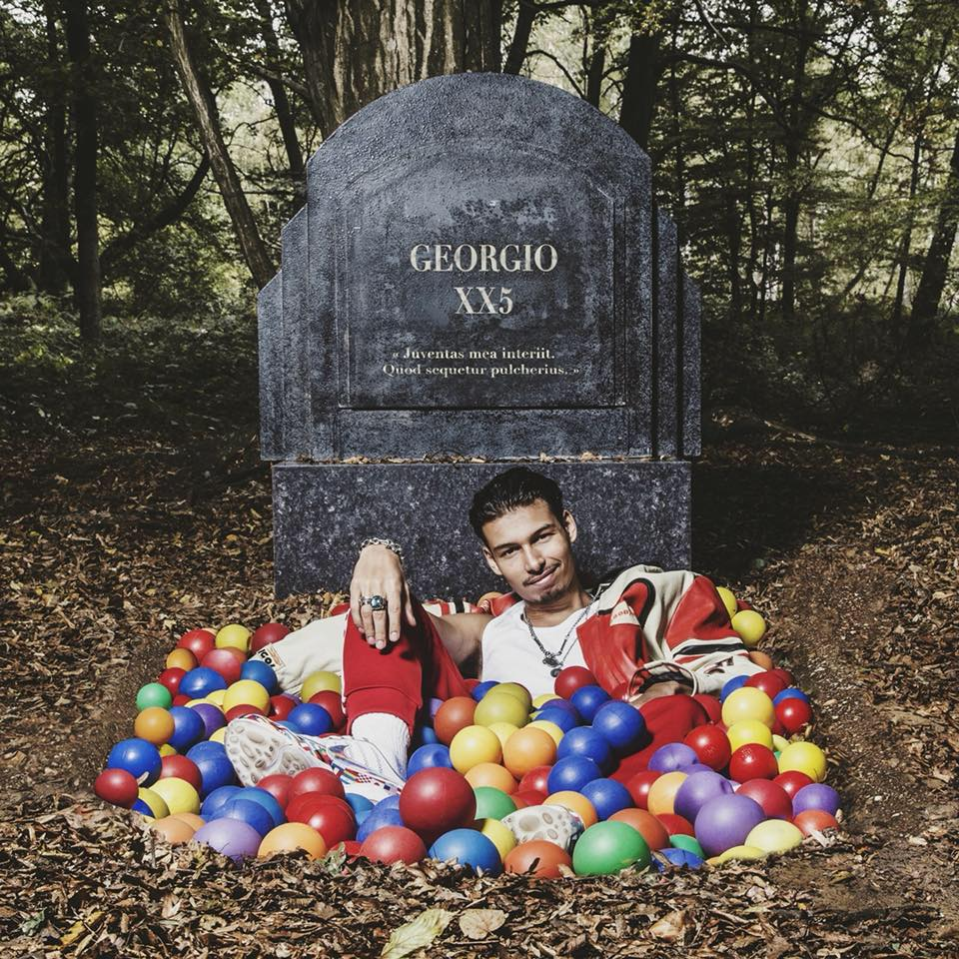
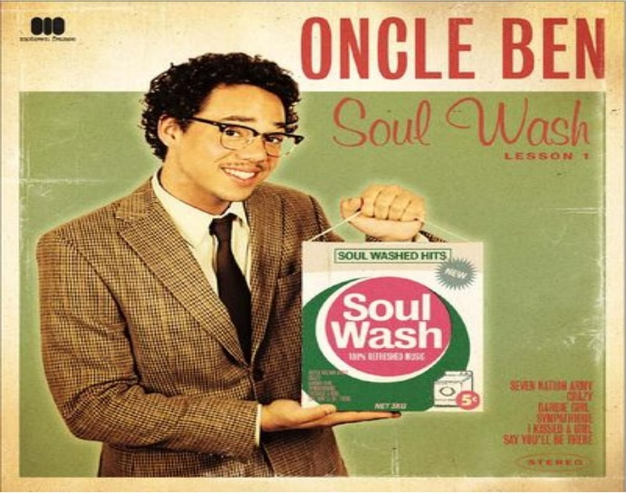

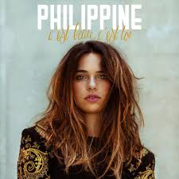
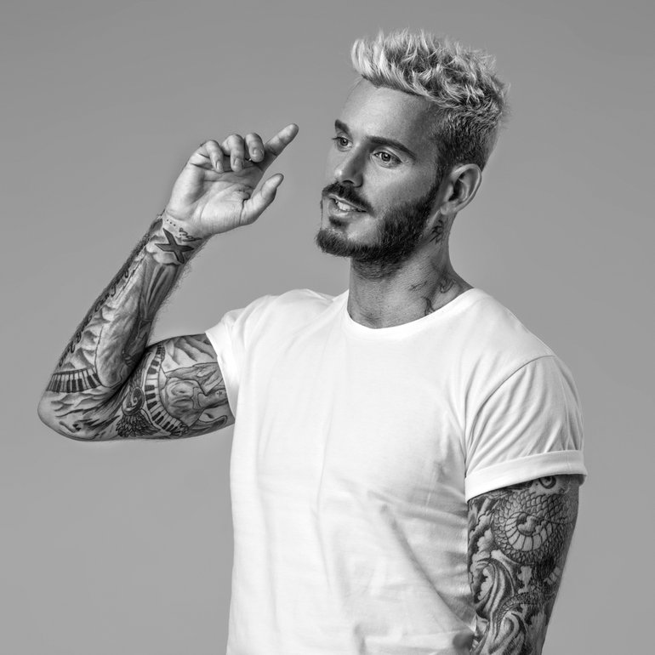
Des chanteurs français
Also check out these French singers and pop groups!
French Pop
R & B
Pop
Hip Hop
Dadju
Christine & the Queens
Georgio
Aöme
Soul
Teen Pop
French Pop
French Pop
Ben l’Oncle Soul
Kids United
Philippine
M.Pokora

Slide 16

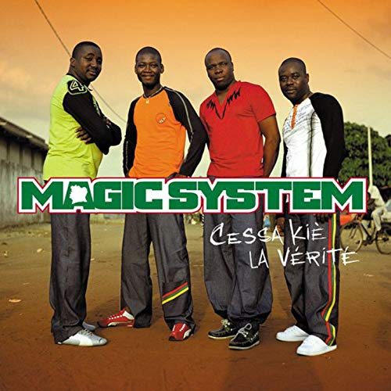
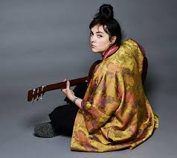
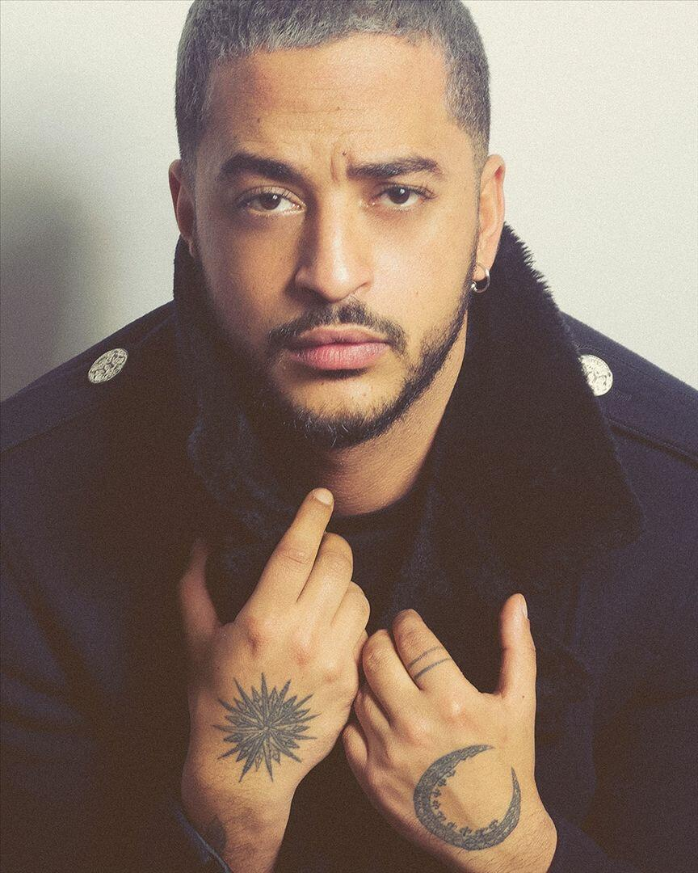
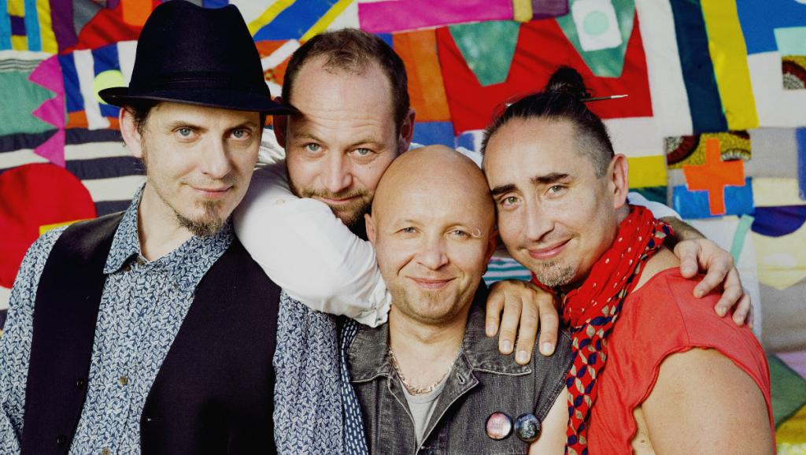
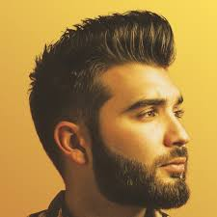
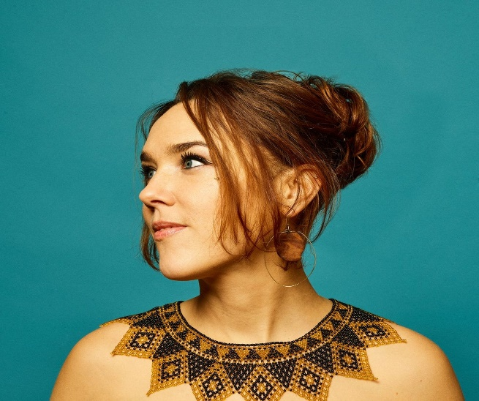
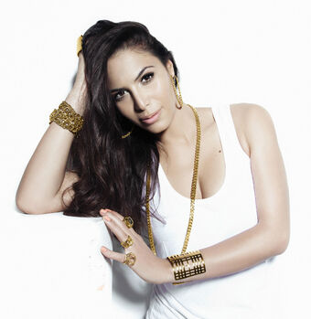
Des chanteurs français
Also check out these French singers and pop groups!
French Pop
Afrobeats
French Pop
Hip Hop
Magic System
Hoshi
Slimane
Aya Nakamura
Acoustic
Pop Folk
French Pop
R & B
Tryo
Kendji Girac
ZAZ
Zaho

Slide 17


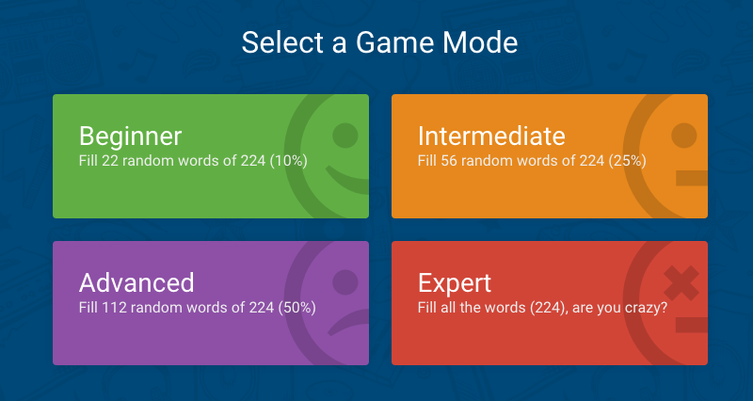

Learn languages through music now on your smartphone!
Find news songs, watch music videos, learn the lyrics by playing games or sing along using the karaoke game mode.
Visit www.lyricstraining.com or download the app now for free!

Slide 18


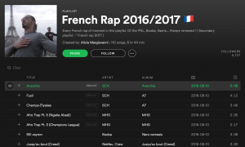
Search for some of the artists on this display.
Create your own playlist of French music to listen to in your spare time.
Search for playlists that others have already made and shared on Spotify.

